Slide 1
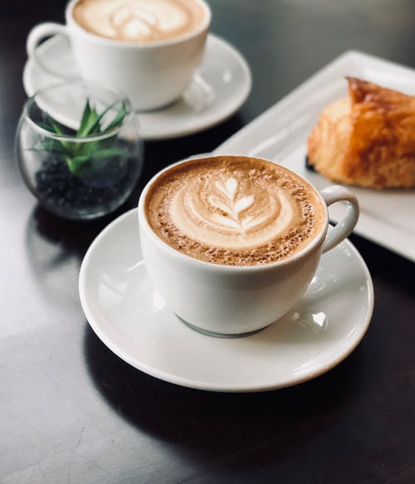
Strange Brew Austin Coffee
Analysis of customer reviews on Yelp.com.

Slide 2
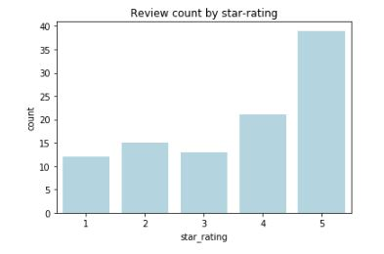
Number of reviews based on star-rating
Percentage of total reviews:
Five-star – 39%
Four-star – 21%
Three-star – 13%
Two-star – 15%
One-star – 12%

Slide 3
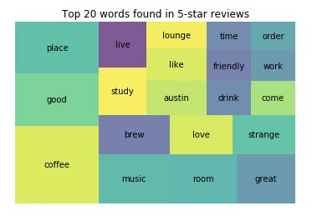
The Good: Top 20 most common words found in five-star reviews
What customers like:
Live music
A place to hangout or study
Good coffee

Slide 4
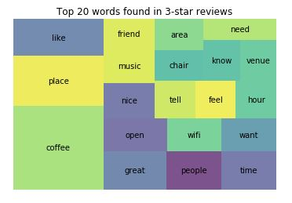
The OK: Top 20 most common words found in three-star reviews
Things customers find OK:
Music
Wi-Fi access
Great is still there, but fewer positive words overall

Slide 5
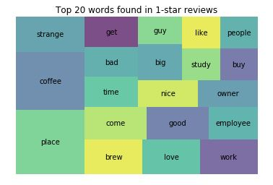
The Bad: Top 20 most common words found in one-star reviews
Things customers find bad:
Issues with employees and owner
The word “bad” makes the top 20

Slide 6
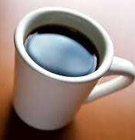
Recommendations
What we do well:
Continue bringing in live music
Continue offering Wi-Fi access
Areas for improvement:
Our best positive word in five-star reviews was only good
Better coffee and a focus on customer service

